Slide 1
April 2019 Presentation

Slide 2
INTRODUCTION 2
CURRENT BUSINESS SEGMENTS 7
FINANCIALS 13
2019 OUTLOOK 16
CONTACT 22
This presentation contains forward-looking statements within the meaning of the federal securities laws including statements related to future products and services we anticipate providing, the potential amount of revenue our Pueblo, Colorado facility can generate in future periods, the anticipated uses of our “Greenhouse” headquarters, our future plans, our expectations regarding new businesses in which we may expand and future acquisitions, our expectations about future developments in the regulated cannabis industry and markets, and any statements or assumptions underlying any of the foregoing. Such statements are based on management's current expectations and are subject to a number of uncertainties and risks that could cause actual results to differ materially from those described in the forward-looking statements. These statements may include words such as “anticipate,” “estimate,” “expect,” “project,” “plan,” “intend,” “believe,” “may,” “will,” “should,” “likely” and other words and terms of similar meaning in connection with any discussion of the timing or nature of future events. We cannot assure you that future developments affecting us will be those that we have anticipated. Important risks and uncertainties that could cause actual results to differ materially from our expectations include, among others, those risks and uncertainties disclosed in the “Management’s Discussion and Analysis of Financial Condition and Results of Operations” and “Rick Factors” sections of our most recent Form 10-K and Form 10-Q filed with the Securities and Exchange Commission, and similar disclosures in subsequent reports filed with the Securities and Exchange Commission. Any forward-looking statement made by us in this presentation speaks only as of the date on which we make it. We undertake no obligation to publicly update any forward-looking statement, whether as a result of new information, future developments or otherwise, except as may be required by any applicable securities laws. The content of this presentation is provided for information purposes only, and is not intended for trading or investment purposes.

Slide 3
INTRODUCTION

Slide 4
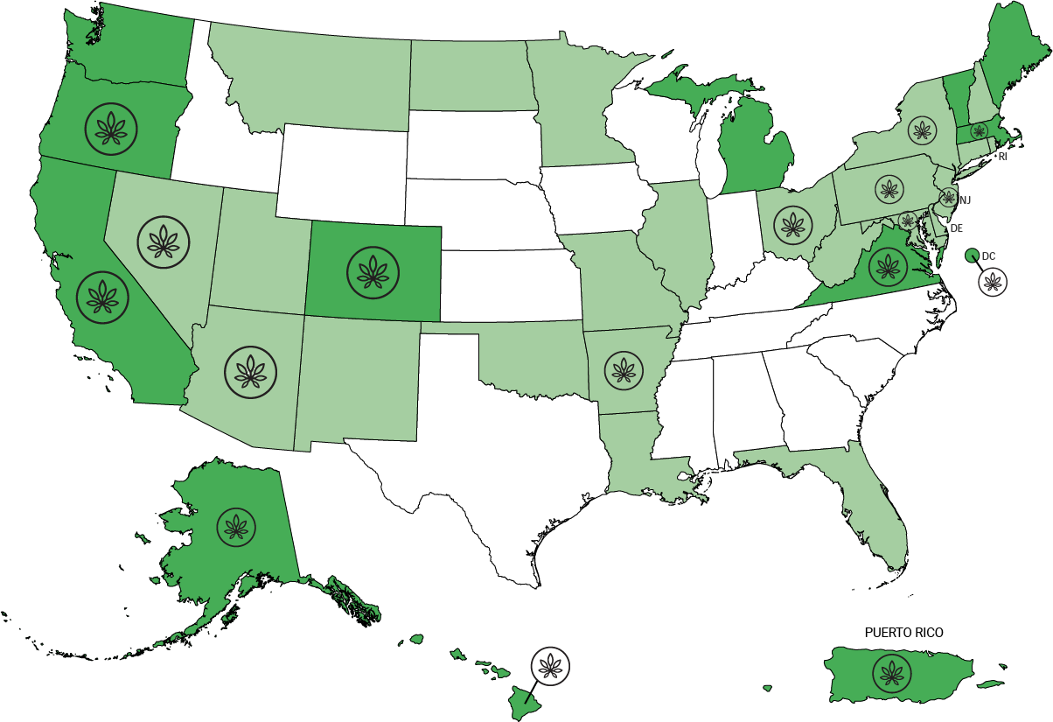
As of: 02/28/19
SHARES
OUTSTANDING
Market
Capitalization
36.2
MILLION
$82.2
MILLION
CURRENT BUSINESS SEGMENTS
Security and Cash
Transportation
“Security”
Consumer Goods and Marketing Consulting
“Consumer Goods”
4 OFFICES
Denver, CO
Long Island, NY
Los Angeles, CA
Sacramento, CA
GC Markets
Operations Consulting
and Products
“Operations”
Capital Investments and Real Estate
“Investments”
// Sarbanes-Oxley Compliant
// Strong Management Team
// 91 Employees
// OTCQX Listed
// Deep Industry Experience
PROFESSIONALS
Accounting & Audit Firm
Securities Counsel:

Slide 5
OUR portfolio OF COMPANIES

Slide 6
Brian
Andrews
Chief
Financial
Officer
Michael
Feinsod
Interim
CEO
Joe Hodas
Chief
Operating
Officer
LEADERSHIP
CORPORATE
DEVELOPMENT
MARKETING
LEGAL
ACCOUNTING
HUMAN RESOURCES
Hunter Garth
VP Corporate Development
Cindy Gonzales
VP Marketing
Brett Wendt
EVP General Counsel
Jessica Bast
VP Controller
Kate Honas
HR Manager
FAMILY OF BRANDS

Slide 7
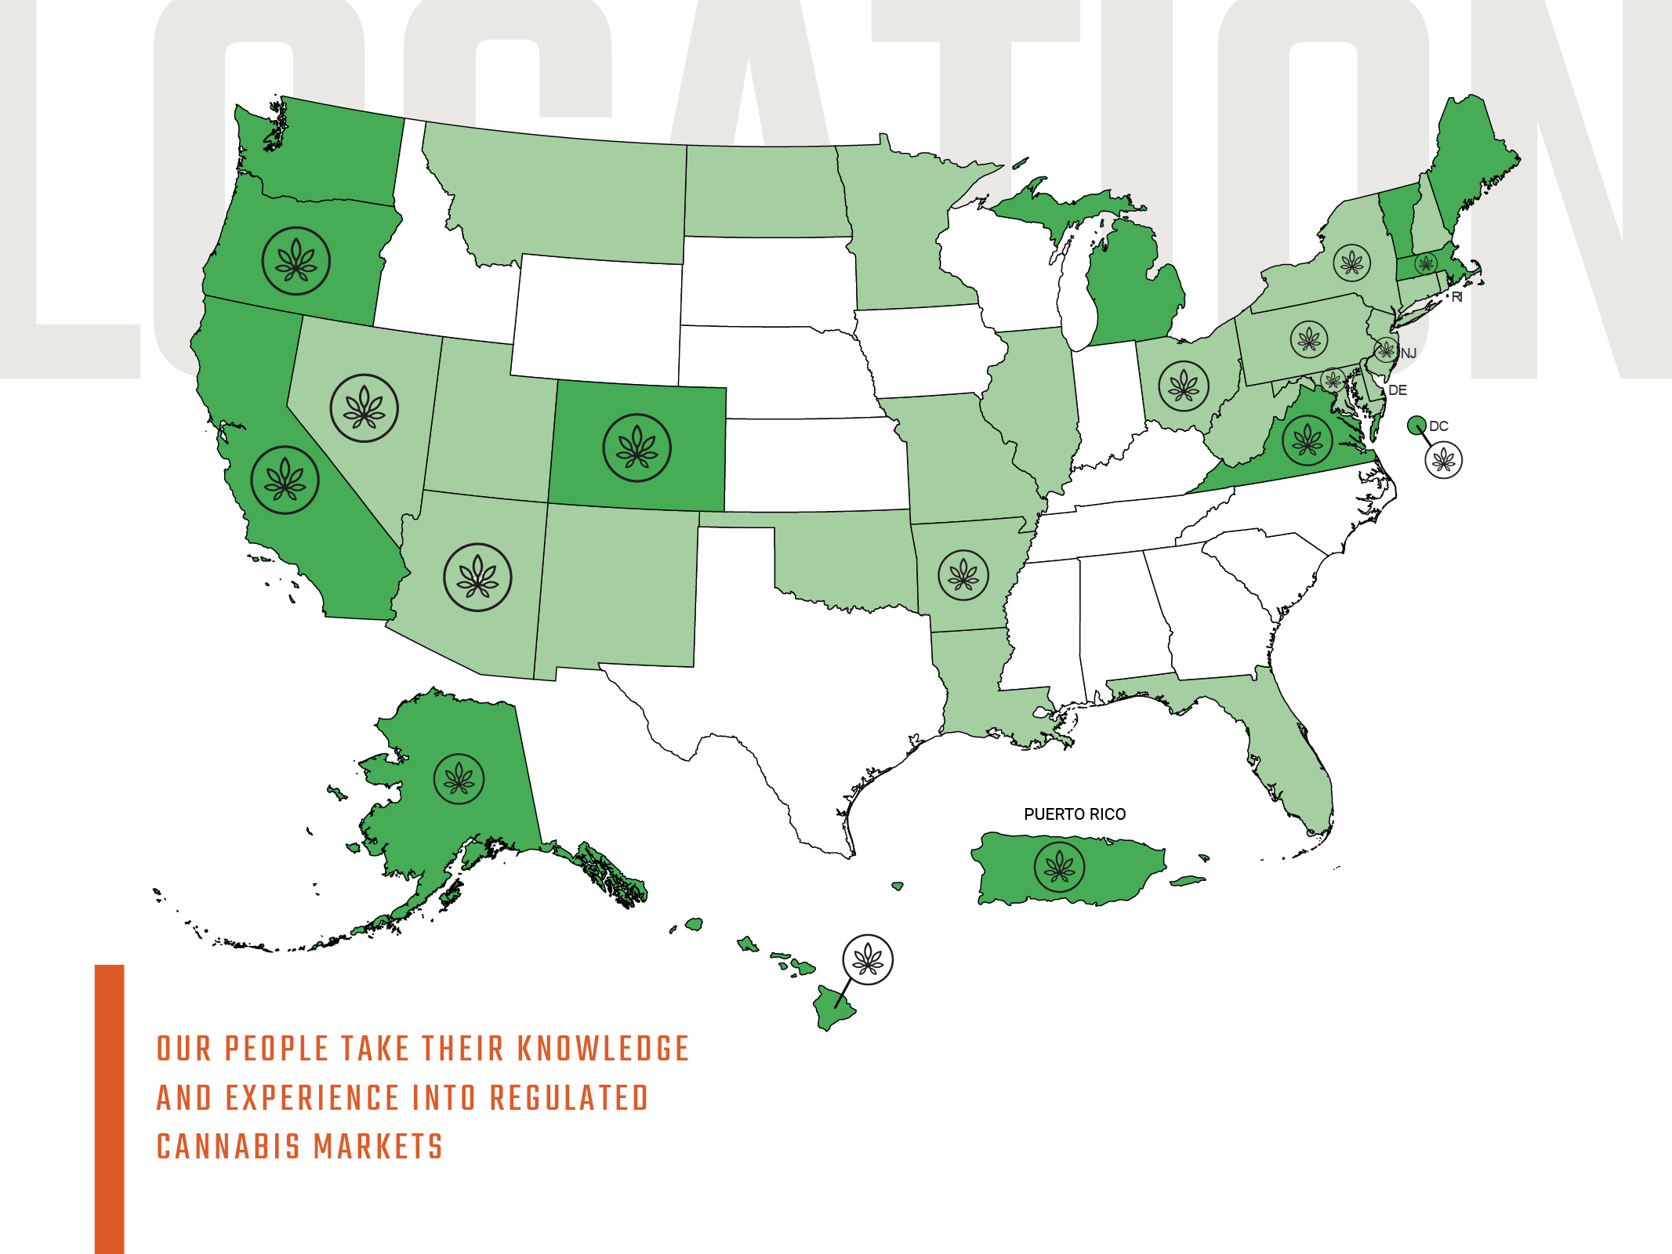
Recreational & Medical Cannabis
Medical Cannabis
Illegal Cannabis
GC Markets

Slide 8
CURRENT BUSINESS SEGMENTS

Slide 9
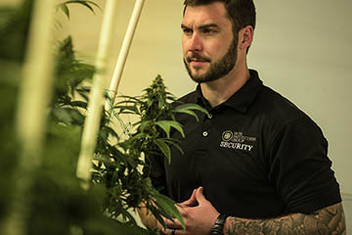
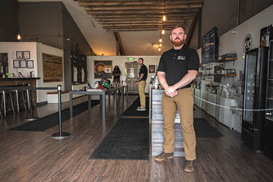
ironprotectiongroupsecurity.com
CURRENT BUSINESS SEGMENT - SECURITY
// Founded by/employs veterans
// Multi-state presence
// Security planning
// Physical security
// Camera install & monitoring
Iron Protection Group (IPG) is proud to be one of the fastest-growing security companies in the nation. Our operators, many who are US Veterans, remain aware and enforce compliance in all laws and regulations pertaining to their function within our client’s business. At IPG, we have a vision of security that is different from other security companies. We take an unobtrusive approach to security. We strive to keep the spotlight off of us and our activities while providing safety and security so our customers can focus on what they do best.

Slide 10
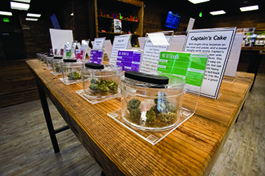
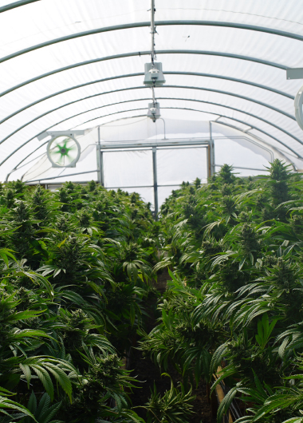
nextbigcrop.com
CURRENT BUSINESS SEGMENT - OPERATIONS
// License Application and Procurement // Design and Build Services
// Managed Services
// Operational Costs
// Standard Operating Procedures // Supply Chain Management
Next Big Crop offers unparalleled management and consulting services in an industry that has traditionally lacked sound operational and quality standards. We deploy proven solutions for every phase of medical and adult-use cannabis business operations, from licensure, design and construction, to the cultivation, manufacture and sale of medical-grade cannabis product.

Slide 11
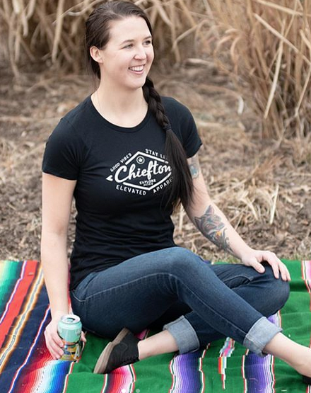
chieftonsupply.com
// Mainstream and e-commerce distribution
// Custom designs
// Hemp and sustainable textiles
// Penetration in multiple states
// Cannabis culture for the masses
// Design Services
CURRENT BUSINESS SEGMENT – CONSUMER GOODS
Chiefton Supply Co. creates innovative eco-conscious apparel that inspires and supports the global cannabis community.
Our mission is to create the highest level of function, relevance, comfort, in the most responsible way possible. Our apparel and accessories utilize textiles like hemp, organic cotton, and recycled polyester which deliver performance, comfort, and accountability. What you wear matters and Chiefton will consistently strive to provide eco-friendly apparel, accessories, and printing techniques.

Slide 12
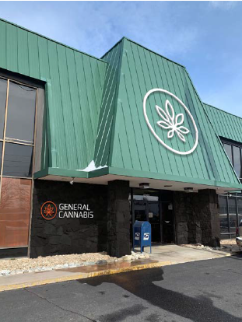
GC CAPITAL
// Debt and equity investments
// Inventory and equipment financing
// Acquisitions
// Start-up capital
// Real estate loans
// Business loans
CURRENT BUSINESS SEGMENT - INVESTMENTS
One of the most critical factors for the cannabis industry is access to capital. Being well capitalized with strong, value added input from the right partner can mean the difference between a great idea and true success in one of the fastest growing industries in history.
GC Capital is designed to provide “smart” capital to entrepreneurs and established companies throughout the cannabis industry.

Slide 13
RETAIL CBD
// Brick and mortar retail store
// Expansive product offering of CBD products
// Natural extensions are store-within-store and POP solutions
// E-Commerce site // Opening Spring 2019
CURRENT BUSINESS SEGMENT – CONSUMER GOODS

Slide 14
FINANCIALS

Slide 15
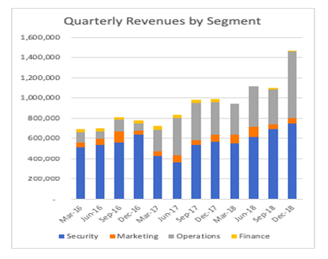
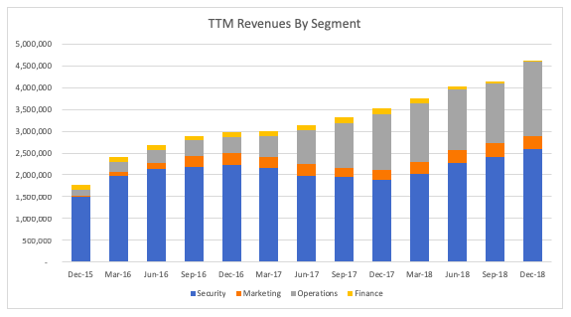
Quarterly revenue growth
Quarterly Revenues by Segment
TTM Revenues by Segment
https://www.sec.gov/edgar.shtml

Slide 16
Sarbanes-Oxley Compliance
COMPLIANMCE
Evaluation of Disclosure Controls and Procedures
We maintain disclosure controls and procedures (as defined in Rules 13a-15(e) and 15d-15(e) under the Securities Exchange Act of 1934, as amended (the “Exchange Act”) that are designed to ensure that information required to be disclosed in our reports filed under the Exchange Act, is recorded, processed, summarized and reported within the time periods specified in the Securities and Exchange Commission’s rules and forms, and that such information is accumulated and communicated to our management, including our Principal Executive Officer and Principal Financial and Accounting Officer, as appropriate to allow timely decisions regarding required disclosure.
We carried out an evaluation under the supervision and with the participation of management, including our Principal Executive Officer and Principal Financial and Accounting Officer, of the effectiveness of the design and operation of our disclosure controls and procedures as of December 31, 2018, the end of the period covered by this report. Based on that evaluation, our Principal Executive Officer and Principal Financial and Accounting Officer have concluded that our disclosure controls and procedures were effective as of December 31, 2018.
Internal Control over Financial Reporting
Our management is responsible for establishing and maintaining adequate internal control over financial reporting as defined in Rules 13a-15(f) and 15d-15(f) promulgated under the Exchange Act as a process designed by, or under the supervision of, our principal executive officer and principal financial officer and effected by the Board, management, and other personnel, to provide reasonable assurance regarding the reliability of financial reporting and the preparation of financial statements for external purposes in accordance with GAAP and includes those policies and procedures that:
· Pertain to the maintenance of records that in reasonable detail accurately and fairly reflect the transactions and dispositions of the assets of the Company;
· Provide reasonable assurance that transactions are recorded as necessary to permit preparation of financial statements in accordance with GAAP, and that our receipts and expenditures of are being made only in accordance with authorizations of our management and directors; and
· Provide reasonable assurance regarding prevention or timely detection of unauthorized acquisition, use, or disposition of our assets that could have a material effect on the financial statements.
Because of inherent limitations, our internal control over financial reporting may not prevent or detect misstatements. Therefore, even those systems determined to be effective can provide only reasonable assurance with respect to financial statement preparation and presentation. Projections of any evaluation of effectiveness to future periods are subject to the risk that controls may become inadequate because of changes in conditions, or that the degree of compliance with the policies or procedures may deteriorate.
Assessment of Internal Control over Financial Reporting
Our management assessed the effectiveness of our internal control over financial reporting as of December 31, 2018. In making this assessment, management used the criteria set forth by the Committee of Sponsoring Organizations of the Treadway Commission (“COSO”) in Internal Control - Integrated Framework (2013). Based on management’s assessment, management concluded that its internal control over financial reporting was effective as of December 31, 2018, to provide reasonable assurance regarding the reliability of financial reporting and the preparation of financial statements in accordance with GAAP.

Slide 18
Quarterly revenue growth
Enable each of our existing operating divisions to expand nationally
WHAT’S NEXT?
Continue to strategically acquire and invest in emerging companies throughout the industry.

Slide 19
2019 Plans
Continued expansion in California
Camera monitoring
Guard training
Implement compliant security services for companies who recently obtained licenses
Growth through acquisition, as well as expansion into new markets
Expand our portfolio of loans
Launch a loan origination and servicing business
Continue to invest in high-growth companies within the cannabis industry
KEY OBJECTIVES PER SEGMENT
Expand our wholesale equipment and supply business to companies beyond our consulting clients via an online sales portal
Sell standard operating procedures through an online sales portal
Pursue opportunities to own and operate our own cannabis grow facility and / or dispensaries
Continue to assess acquisition targets that are complimentary and / or expansive to our consulting business
Spring 2019; Opening athlete and wellness retail CBD Store in Long Island, NY with plans to expand concept nationwide
A curated collection of high quality CBD products. Plan to quickly expand into mail order and partner with other retailers
Pursue relationships with non-cannabis national and regional apparel retailers and distributors, as well as expand our product line nationwide within the cannabis industry
Actively identify and evaluate acquisition targets within the the apparel and consumer goods space

Slide 20
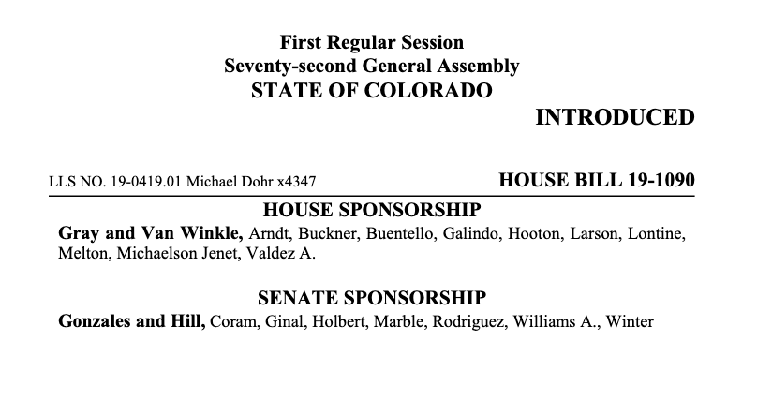
Pubco
PUBCO
Pubco bill will permit public company ownership of Colorado marijuana licenses
We expect significant industry consolidation upon passage
CANN is well positioned to capitalize on market consolidation

Slide 21
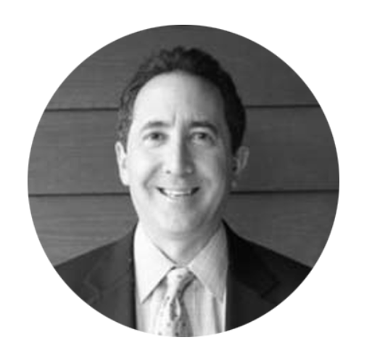
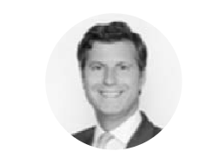
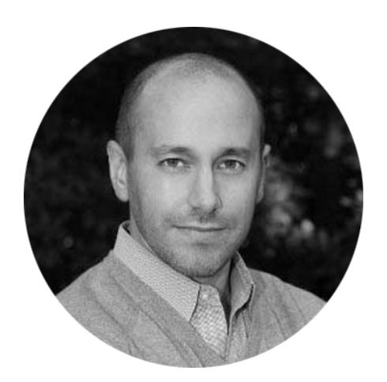
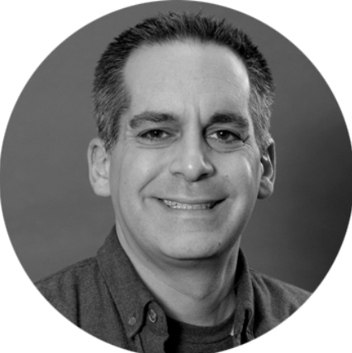
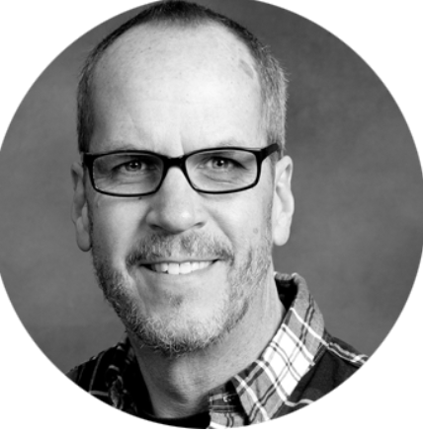
BOARD OF DIRECTORS
Michael Feinsod
Peter Boockvar
Duncan Levin
Mark Green
Robert Frichtel
CHAIRMAN and INTERIM CEO
DIRECTOR
DIRECTOR
DIRECTOR
DIRECTOR
Mr. Feinsod is the Managing Member of Infinity Capital, LLC, an investment management company he founded in 1999. From 2006 through 2013, he served in various executive positions at Ameritrans Capital Corporation, a business development company. Mr. Feinsod served as a director of Ameritrans Capital from December 2005 until July 2013. Mr. Feinsod was an investment analyst and portfolio manager at Mark Boyar & Company, Inc., a broker-dealer. He is admitted to practice law in New York and served as an associate in the Corporate Law Department of Paul, Hastings, Janofsky & Walker LLP. Mr. Feinsod holds a J.D. from Fordham University School of Law and a B.A. from George Washington University.
Mr. Boockvar is the Chief Investment Officer of Bleakley Advisory Group, a multi-billion dollar wealth management firm. He is also the Editor of The Boock Report, a macro economic and market newsletter. He is also a CNBC contributor. Prior he was the Chief Market Analyst with The Lindsey Group, a macro economic and market research firm. Before this he spent a brief time at the hedge fund Omega Advisors as a macro strategist and portfolio manager. Previously, he was a partner at Miller Tabak + Co. for 18 years as the firm's equity strategist and a portfolio manager at Miller Tabak Advisors. Peter graduated Magna Cum Laude with a BBA in Finance from George Washington University.
Mr. Levin is an expert in anti-money laundering, internal investigations, and anti-fraud. After working at the highest levels of state and federal law enforcement, Mr. Levin now consults with businesses facing challenges, including regulatory, investigatory, and anti-fraud issues. He was a line prosecutor and clerked for Hon. Nicholas G. Garaufis on the U.S. District Court. He has practiced privately, lectured for the U.S. DOJ and the District Attorney’s Office. He serves on the Criminal Law committee of the Bar Association for the City of New York. Mr. Levin is a graduate of Yale College, where he was elected to Phi Beta Kappa, and Yale Law School.
Mr. Green has over 18 years of investing experience across public and private markets, spanning several business cycles. In various leadership positions at industry leading firms focused on investment banking, capital markets, private equity and investment management, Mr. Green has been instrumental in the development of several successful platforms and ventures and has built an extensive network of industry contacts and relationships.
Mr. Green is a Co-Founder and Managing Partner of Chatham Road Capital, a credit-focused investment firm that seeks to capitalize on market imbalances and inefficiencies in the public and private markets. Mr. Green oversees all investment activities, portfolio and risk management, and business development. Mr. Green holds an MBA from Columbia Business School and a BS degree from Skidmore College.
Mr. Frichtel served as a managing partner of IBC Capital Group, a commercial real estate and finance company, from 2002 to June of 2013. Since 2010 Mr. Frichtel has consulted for numerous clients throughout the nation that are engaged in the medical marijuana business and has written articles for Bloomberg news regarding the cannabis industry. Between 1999 and 2001, Mr. Frichtel was the president and Chief Operating Officer of EOS Group, a division of Health Net, a NYSE listed healthcare company. Mr. Frichtel received a Bachelor of Science degree in Business Administration from Colorado State University.

Slide 22
OUR STRATEGY
General Cannabis’ strategy for our customers is to act as a single source resource for the cannabis industry. Currently that takes the shape of providing security, marketing, apparel, application and business plan development, large scale cultivation and dispensary design, build, management as well as financing. We execute this strategy through on-going development of our suite of services via acquisition and organic growth of our existing lines of business.
It is our belief that by offering a fully vetted, professional and transparent partnership in what can otherwise be a challenging industry, we can help our customers and partners with time-to-market, efficiency and profitability in a way that is
profound, sustainable and long-term.

Slide 23
Michael Feinsod
Executive Chairman of Board & Interim CEO
michael@generalcann.com
Brian Andrews
Chief Financial Officer
brian@generalcann.com

